Slide 1
High Pressure - High temperature Operations UNIT- II

Slide 2
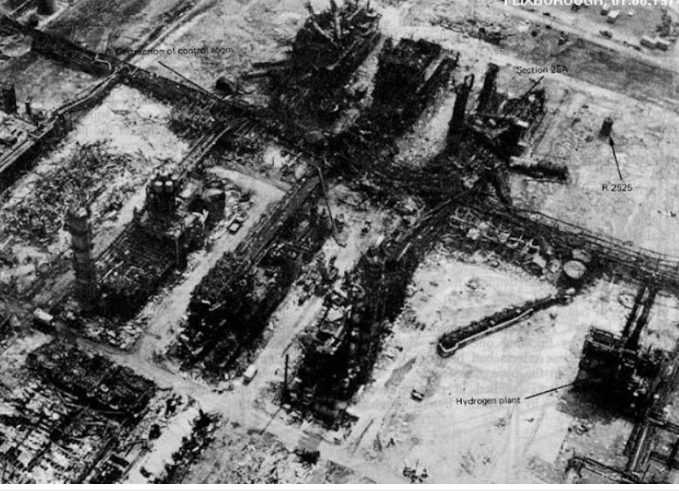
Flixborough Disaster Explosion of a Cyclohexane Cloud
Industrial Disasters
Flixborough Disaster
Seveso Disaster
Chernobyl Disaster
Bhopal Disaster
Date: June 1st, 1974
Place: Flixborough, United Kingdom
Type of accident: Explosion in a cyclohexane processing plant
Outcome: 28 deaths (workers), 89 injured (36 on site, 53 off-site), 1821 damaged houses. Loss about $66 million which is equivalent to $200 million today .

Slide 3
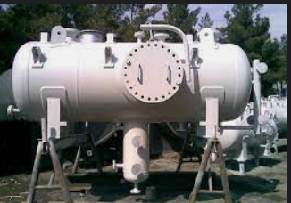
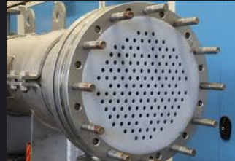
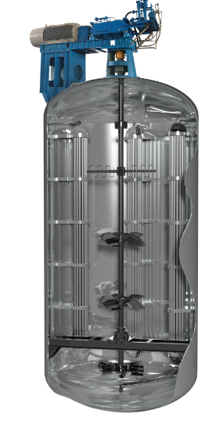
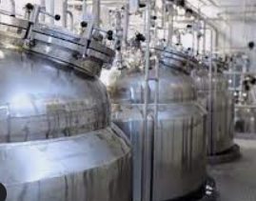
Equipment design problems
Pressure vessel
Heat exchanger
Rotory motion equipments (agitators,..)
Reactors
Agitator

Slide 4
Material of construction
Strength
corrosion resistance
Elasticity
Toughness
Wear
fatigue resistance
ease of fabrication
availability and cost

Slide 5
Precautions in design and construction
High safety standard should be followed -vary according to the type of equipment.
A properly designed piece of equipment will have in-built safety and loss prevention features.
To prevent such failures the ideas and experience which are already available at various points in connection with emergency measures should be incorporated.
Examples :
unit reliability and flexibility
ease of operations
inspection and maintenance
emergency shutdown facility,
design to withstand probable pressure and temperature range, with facility to over pressure/temperature control etc.

Slide 6
Pressure equipment safety
Many types of pressure equipment can be hazardous. These include:
Steam boilers and associated pipework
Pressurised hot-water boilers
Air compressors
Air receivers and associated pipework
Autoclaves
Gas (eg LPG) storage tanks
Chemical reaction vessels.
When things go wrong, these types of equipment can cause serious injuries and even fatalities.

Slide 7
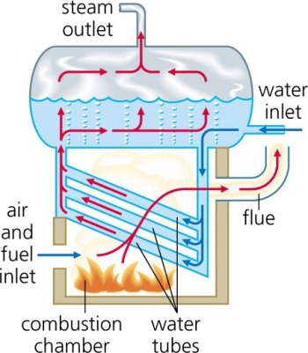
Steam boiler - example
A boiler is a vessel or tank in which heat, produced from the combustion of fuels such as natural gas, fuel oil, or coal, is used to generate hot water or steam
Applications - building space heating to electric power production or industrial process heat.

Slide 8
What Safety Precautions Should One Consider While Working with Pressure Vessels?
https://www.bepeterson.com/4-most-important-safety-precautions-for-operating-pressure-vessels

Slide 9
Timely Maintenance
Proper Knowledge and Training
Understanding Operating Conditions
Installing Protective Devices

Slide 10
How the accident can occur?
If Boiler is unattended at the time of accident
Unexpected rapid increase in steam pressure and consequently safety valves failing to function, disruption occurred
If periodical independent inspection is not done
If the controls to the burners were defective

Slide 11
Pressure deviations
Changes in action of pumping equipment. Eg) failure of pump/compressor
Change of flow eg) closure of valves
Changes in heat input(eg. Heat from sun/fire)
Changes in heat output(eg. Loss of condenser cooling)
Thermal expansion and contraction(eg. Liquid density changes in pipeline)
Chemical reactions and explosion (eg. Runaway reactions)

Slide 12
Design of pressure vessel
Pressure
Temperature
Cyclic conditions
Effect of contents of the vessels
Effect of induced loads from pipework
Effect of weather, snow, wind, earthquake, etc

Slide 13
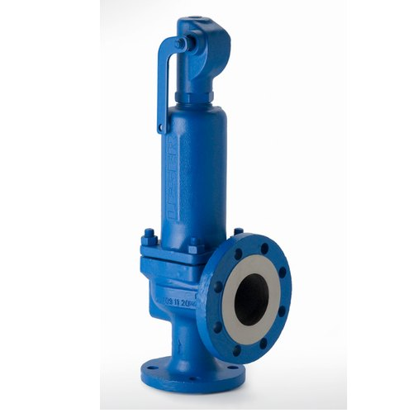
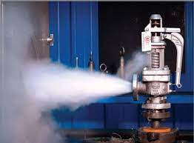
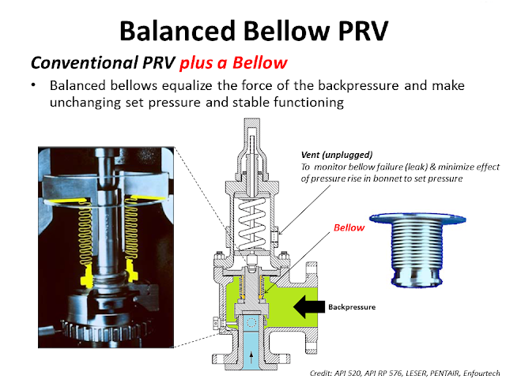
Pressure relief devices
Safety valve
Relief Valve
Safety Relief Valve
-Conventional Safety Relief Valve
-Balanced Bellows Safety Relief Valve

Slide 14
Safety considerations
Range of gauge (not less than one/half times but not greater than twice the operating pressure
Reducing valves – to control the downstream pressure
Water level controls and alarms
Reducing pressure hazard:
Proper storage
Training and testing of personnel
Periodic inspections
Proper operating conditions

Slide 15
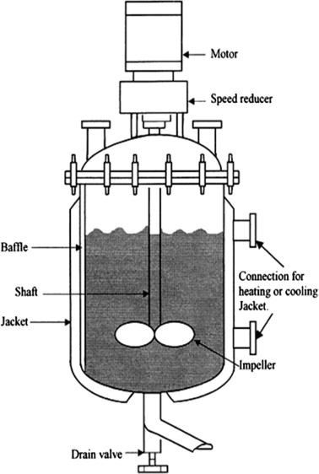
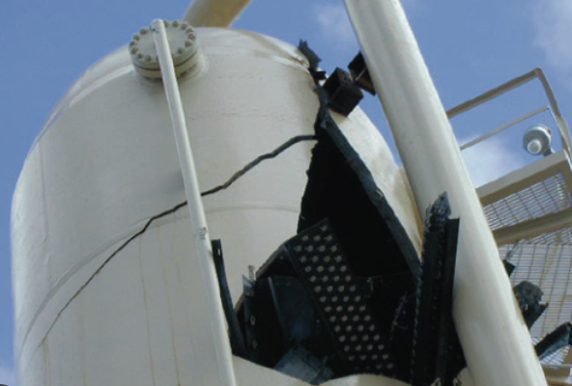
High temperature operations
When the reaction vessel is heated at a very high temperature the materials of construction is limited by reduction in their mechanical properties
High alloy steel – loss of ductility in certain ranges
Mild steel - brittle fracture can be subjected
Brittle fracture in reactor vessel

Slide 16
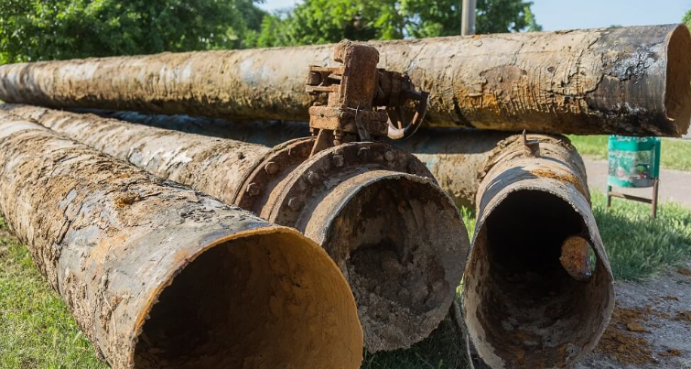
Resistance of the material to corrosion
Choice of materials is very important
Component parts suffer loss of material by corrosion- load carrying capacity is reduced
Even without loss of weight, material become brittle or crack
Corrosion products can cause impurities to the product or impair heat transfer properties
Corrosion resistant materials
Aluminium
Lead
Chromium
Thermoplastics – Polypropylene, polyethylene, nylon
Fibre reinforced plastics, fibre glass
Rubbers – Butyl rubber, neoprene rubber

Slide 17
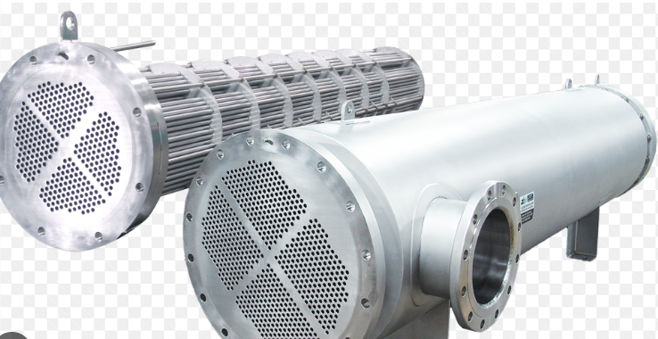
Safety measures
If corrosion can’t be eliminated, acceptable safety can be achieved by designing with excess of materials
In commercial heat transfer apparatus, it operates from temp 455 °F to high temperature of 4000 °F
- Special considerations of heat transfer involving liquid metals and cooling waters
Accumulation of materials will reduce the effectiveness of heat transfer equipment with age
Heat exchange is to control or balance a reactive process- In case of reactor heat removal exactly balance the heat of reaction
Heat exchanger

Slide 18
Temperature deviations in reactor
Sequence errors
Delay in initiating agitation
Temp variations or feed flow
Maldistribution of reactants
Fouling of heat transfer surfaces
Causes:
Changes in heat input (fuel loss)
Changes in heat output (loss of cooling)
Changes in heat transfer (fouling of heat exchangers)
Generation of heat (runaway reaction)
Thermal lags (eg,lags in heat exchanger)

Slide 19
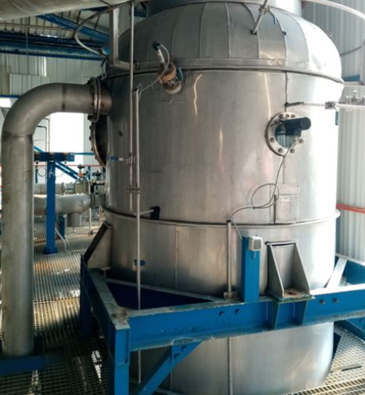
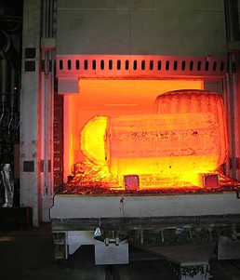
Heat transfer equipment
The heat transfer equipment such as
Evaporator
Reactors
Furnaces
heat exchangers
-require some type of heating which may be directly fired with the help of fuel, electric heating, or using heat transfer media like steam or heating fluids
Evaporator
Furnace

Slide 20
In such equipment the heat absorbed by the tubes must be continuously removed by circulating the fluids and to prevent excess temperature rise through the liquid film heat transfer coefficient should be sufficiently high.
Periodic inspection of the equipment is necessary and for that reason sufficient numbers of inspection opening must be provided, if applicable.

